Slide 1

[Enter Presenter name &
Organization]
Why Falls Matter
{enter Date of presentation]
Notes:
Thank you for being here. [introduce yourself and your organization].
Today we’re talking about Why Falls Matter — not just as isolated events, but as preventable, life‑changing injuries that we see far too often in Iowa. My goal is to help you understand the risks, the opportunities, and the practical steps we can all take to prevent falls.

Slide 2
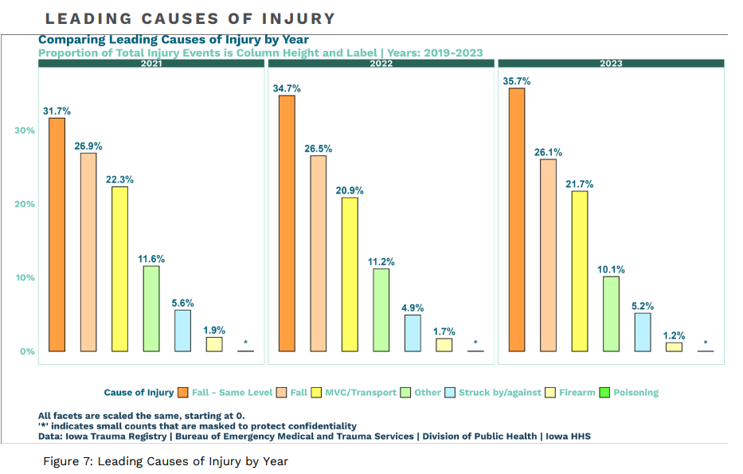
Leading Causes of Injury
2023 Iowa Trauma Registry Report
Notes:
In Iowa, falls remain the leading cause of injury. According to the 2023 Iowa Trauma Registry, we had over 7,100 fall-related injuries last year. That’s an increase from the previous year and represents more than a quarter of all injury events in the state. This trend shows us that falls are not just common — they’re persistent, and they’re affecting a wide range of people.
Note to the Presenter: the trauma report is hyperlinked on the slide https://publications.iowa.gov/51448/1/iowa_2023_trauma_registry_report_final 12.23.2024.pdf

Slide 3
One Fall Can Lead to Another
Across all types of hospitals, more people are injured from falls than from car crashes or any other causes.
What we’re seeing in Iowa is that it’s not just about falling once. We are seeing big increases in repeat injuries.
A reason for that is falls. One fall can make it more likely that another one happens. And in some cases, people are getting injured multiple times in a single year.
Falls prevention is important because it isn’t just about preventing that first fall; it’s about breaking the cycle so one fall doesn’t turn into two, three, or more.
Notes:
What’s especially concerning is that one fall often increases the risk of another. We’re seeing more repeat injuries — multiple falls happening to the same individual within a single year. That means falls aren’t just accidents; they can become a cycle that affects mobility, confidence, independence, and long-term health.
Note to the Presenter: the trauma report is hyperlinked on the slide. https://publications.iowa.gov/51448/1/iowa_2023_trauma_registry_report_final 12.23.2024.pdf

Slide 4
The Good News!
Falls Are Not Inevitable
Many falls can be prevented
Small changes can make a big difference
It’s not just about avoiding a first fall, it’s about staying independent and safe
There are steps you can take today to reduce your risk.
Notes:
Here’s the encouraging part: falls are not inevitable. Many can be prevented with small, simple changes. It’s about staying strong, staying aware, and staying independent.
During the remainder of this presentation, you will learn what you can do to prevent falls.

Slide 5
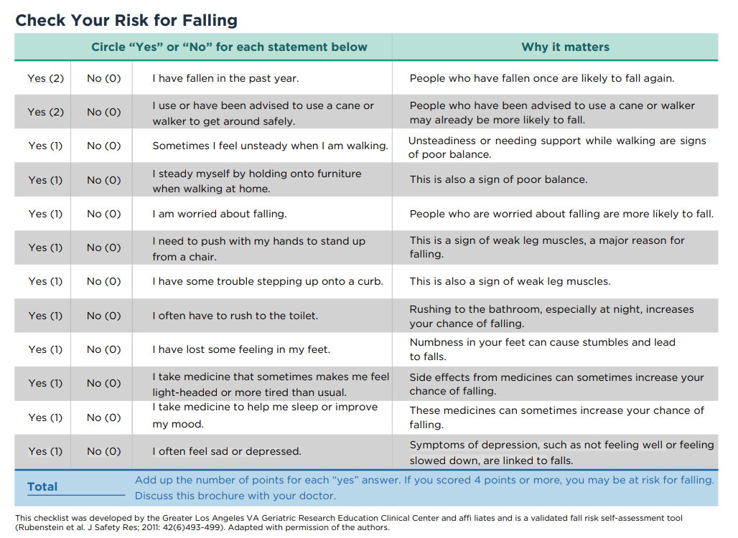
Stay Independent Fall Risk Self Assessment
Our Stay Independent Brochure contains this questionnaire and other falls prevention info.
Show your score to your doctor for a fall risk screening.
Notes:
The Stay Independent Brochure includes a questionnaire that helps people check their fall risk. After you complete the assessment, it’s a great tool to share with your provider to start the conversation about their recommendations for reducing your fall risk. Early screening is one of the best ways to catch risks before an injury happens.
Note to presenter: The brochure is a hyperlink on the slide and available at https://iacommunityhub.org/wp-content/uploads/StayIndependent-Brochure-IAcommunityHUB-compressed-1.pdf-1.pdf. If you would like hard copies of the brochure, please feel free to print them or request a bundle (in quantities of 50) from brain.injury@hhs.iowa.gov

Slide 6
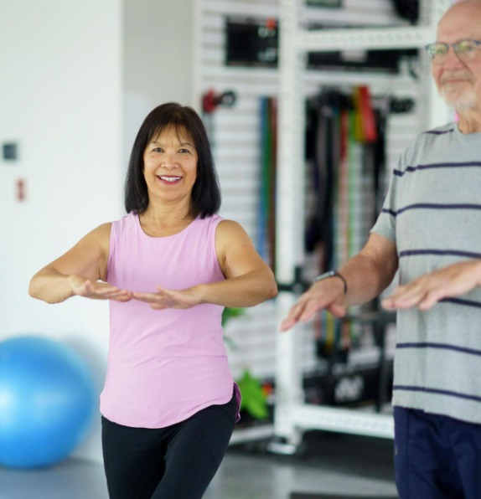
Move Your Body, Reduce Your Risk
Less movement = weaker muscles and poorer balance
Exercise improves strength, balance, and coordination
Even light activity can help reduce fall risk
Falls prevention programs are classes or coaching programs that help people stay strong, steady, and safe so they can avoid falls.
These programs are proven to reduce falls by helping people build strength, balance, and confidence
Most of these programs combine exercise with education
Notes:
Reduced movement leads to weaker muscles and poorer balance, but the good news is that even small amounts of activity can improve strength and stability. Many falls prevention programs combine exercise with education — they’re proven to reduce falls and increase confidence.

Slide 7
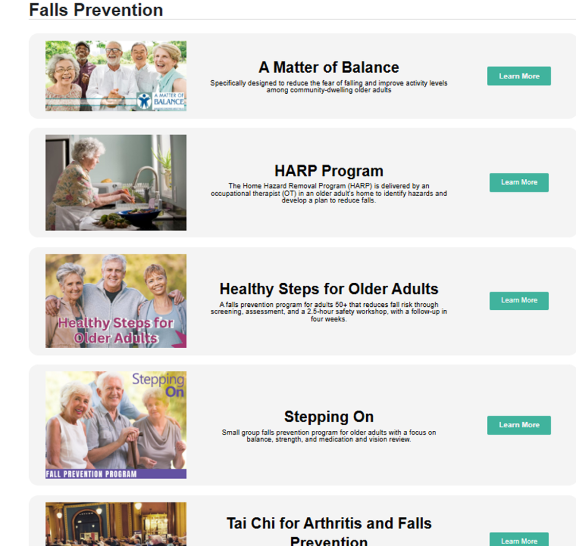
HUB Program Library
Notes:
Iowa has many evidence-based programs available. You can discover what might be available near you by visiting the HUB Program Library. The HUB navigators can assist you in finding and enrolling in classes and supports at the level that best meet your unique needs, including general falls prevention education.
Note to the Presenter: more information is available at https://iacommunityhub.org/programs/

Slide 8
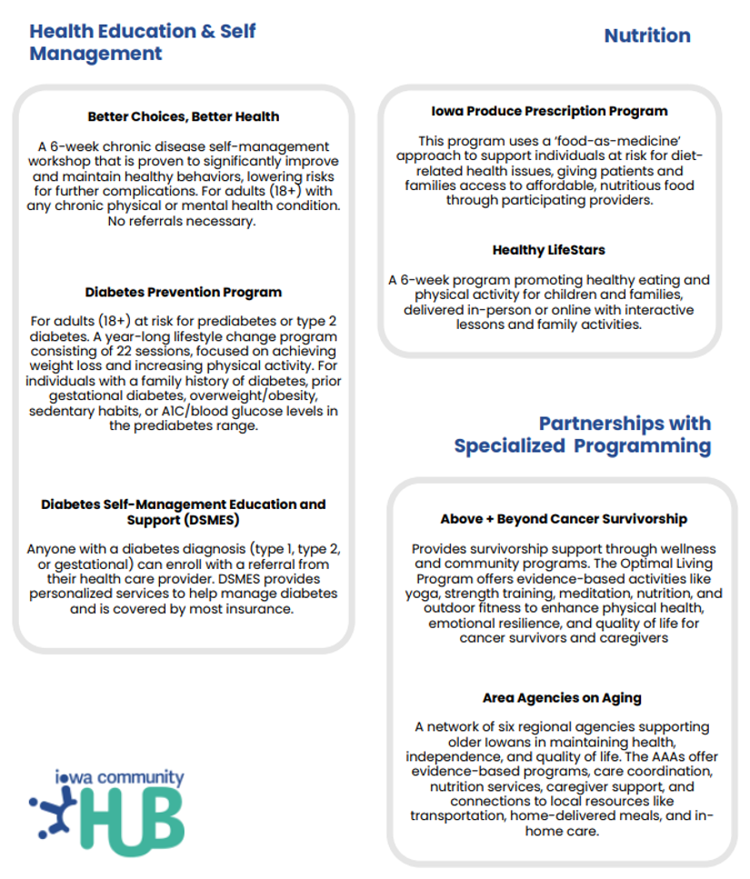
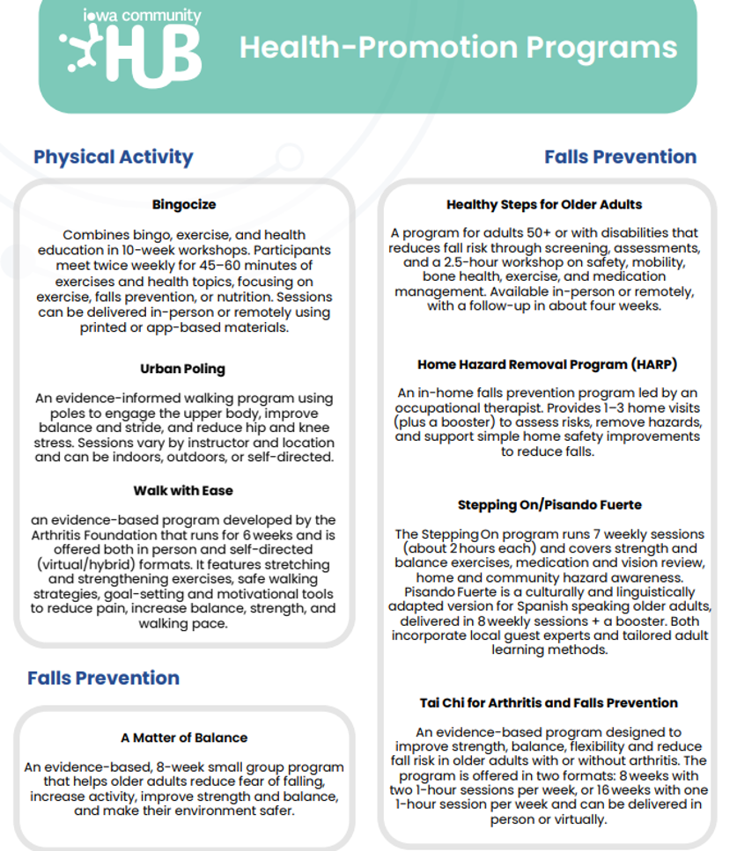
Notes:
The HUB has a variety of health-promotion programs. While some of the programs may not be labelled as falls prevention, they all address a component of falls prevention whether that is improving nutrition or increasing physical activity. This is just another example of how the HUB might be able to find a resource that meets your needs and individual interests. So, if one program doesn’t feel like a good fit you may have another option available to you.
Note to Presenter: This list of programs is available at https://iacommunityhub.org/wp-content/uploads/HUB-Program-Handout.pdf please share this link or print a list for attendees.

Slide 9

Check Your Medications
Know what you’re taking
Some medications can cause:
  Dizziness
  Drowsiness
  Balance issues
Risk increases with multiple medications
Talk to your doctor or pharmacist
  Ask: “Could any of these increase my fall risk?”
Notes:
Medications can affect balance, dizziness, and alertness. That risk increases when someone is taking multiple medications. This is an easy thing to check: ask the doctor or pharmacist, ‘Could any of these increase my fall risk?’

Slide 10
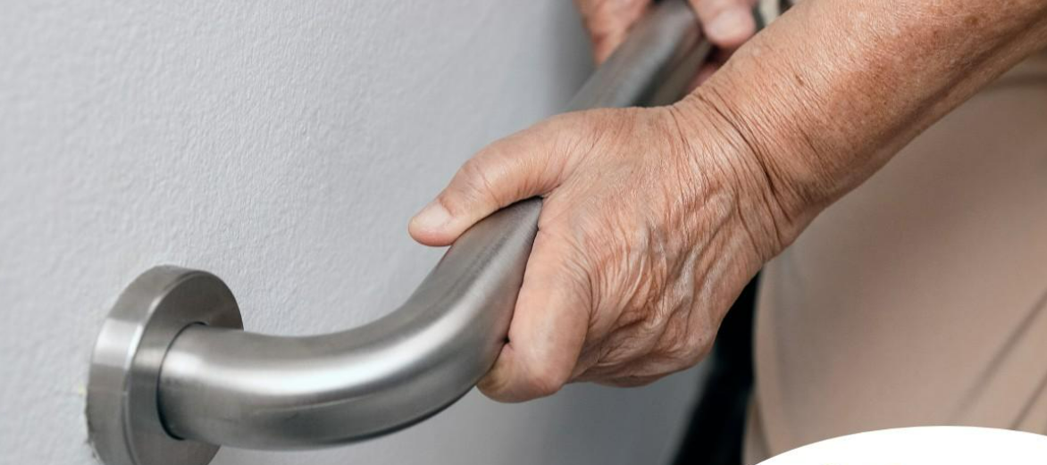
Make Your Home Safer
Most falls happen at home and small fixes can prevent big injuries.
  Remove tripping hazards (rugs, clutter, cords)
  Improve lighting
  Install grab bars and handrails
  Use non-slip mats
Ask your doctor about a home safety assessment if you feel your home could be safer.
Professionals such as occupational therapists can visit your home and help identify simple changes to reduce your risk of falling.
Notes:
Most falls happen at home. Simple changes like removing rugs, improving lighting, or installing grab bars can have a big impact. Occupational therapists can even conduct home assessments to help identify hazards
Note to Presenter: feel free to share examples of common environmental changes, resources in your community or share/display low tech devices. Easterseals Iowa is a resource to check out assistive technology on loan to try, or to access durable medical equipment. Learn more about Easterseals AT program at Home - Easterseals Iowa | Assistive Technology Program

Slide 11
Don’t Ignore Vision & Hearing
Simple solutions:
  Annual vision and hearing checks
  Update glasses and properly fitted hearing aids
  Optimize home lighting, visual contrast and clear visual paths.
Notes:
Poor vision and hearing are often invisible risk factors that make it harder to detect hazards. Regular exams can drastically reduce fall risk by improving awareness of surroundings. And when someone has both vision and hearing loss, their fall risk is the highest of all.
Often these risks can be addressed with low-effort solutions: annual eye and ear exams, keeping prescriptions current, using proper eyewear, hearing aids, and improving home lighting and contrast.
Let’s think of vision and hearing care as an essential component of any falls prevention plan and for maintaining independence.

Slide 12
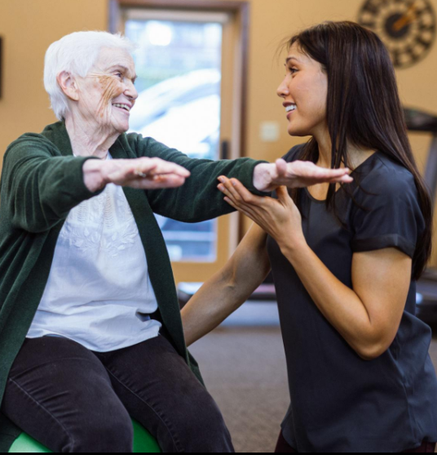
Manage Your Health
Chronic conditions can increase fall risk:
  Arthritis or chronic pain
  Neurological conditions such as Parkinson’s Disease or Multiple Sclerosis
  Neuropathy (numbness/tingling) from diabetes or other conditions
  Cancer-related fatigue
  Conditions that restrict breathing such as Chronic obstructive pulmonary disease (COPD)
  Poor nutrition or dehydration
As a starting point, a physical therapist can help by improving strength, balance, and mobility, and by providing exercises and strategies tailored to your specific condition to help reduce your risk of falling.
Notes:
Learning how to best manage a chronic condition can help you stay strong and steady.
Note to the Presenter: Feel free to include a success story if you have one of an individual engaged in addressing chronic conditions through one of these programs. You may want to reference the HUB and the classes available in your area again as these might not be marketed as falls prevention.

Slide 13
Other Common Causes of Falls
Know some of the top risk factors:
  Unsafe footwear (slippery or loose shoes)
  Alcohol use
  Poor lighting
  Uneven surfaces (stairs, sidewalks)
  Rushing or multitasking
  Improper use of assistive devices (canes/walkers)
  Weather conditions (ice, rain)
  Animals under your feet
Many of these risk factors are addressed in a falls prevention program.
Notes:
Falls can also happen due to footwear, alcohol, poor lighting, uneven surfaces, or rushing. Many of these are addressed in falls prevention programs, and most can be changed quickly.
Note to Presenter: This is another opportunity to talk about modification not covered earlier.
A recommendation for pets can be to attach a bell to their collar to alert the individual of the pet’s location, or rushing to the bathroom is a common issue, so could the individual benefit from physical therapy for pelvic floor strengthening?

Slide 14
Get Involved!
The Iowa Falls Prevention Coalition (IFPC) is a group of organizations and community partners working together to help prevent falls. They focus on raising awareness, providing education, offering support programs, and sharing helpful resources.
Vision: All Iowans will have fewer falls and fall-related injuries, maximizing their independence and quality of life.
Mission: Foster collaboration among state agencies, community organizations, healthcare systems, and others to raise awareness, deliver education, and promote fall prevention efforts.
Notes:
The Iowa Falls Prevention Coalition brings together partners across the state who want to reduce falls and support safe, independent living. Our vision is that all Iowans can live confidently and safely, free from preventable falls. Our mission is to work collaboratively across agencies and communities to increase awareness, education, and coordinated prevention efforts. Community members are encouraged to join as well!
Note to the Presenter: there are also local/regional coalitions that may be of more interest to your audience – feel free to update this slide accordingly. More information about the statewide coalition and the local coalitions is available at Iowa Falls Prevention Coalition - Iowa Community HUB

Slide 15
References
Iowa Department on Aging Evidence-based falls ... (n.d.-a). https://acl.gov/sites/default/files/programs/2016-12/Falls-Prev-Grant-Profile-IA.pdf
Iowa Falls Prevention Coalition Webpage: https://iacommunityhub.org/iafallscoalition/
National Institute on Aging . (2024, December 18). Tips to Prevent Falls . YouTube. https://www.youtube.com/watch?v=aMIvtq2jrDk&t=6s
2023 Iowa Trauma Registry Report https://publications.iowa.gov/51448/1/iowa_2023_trauma_registry_report_final%2012.23.2024.pdf
Notes:
Here are the sources behind the data and materials I’ve shared today.

Slide 16
Thank you
[Include your name, organization and contact information on this page]
Notes:
Falls are preventable, and every step we take — from movement to medication checks, from home safety to community programs — helps people stay independent and healthy. Thank you for being part of this effort. Please let me know what questions you have and feel free to connect with me in the future.
Presenter note: if you have them, you may want to have a brochure or business card as a handout.
You may want to consider asking the audience what action steps they might take (examples: use the Stay Independent tool, check medications, talk to my doctor)

Slide 17
Notes to Presenter:
You may modify this presentation as you feel appropriate. That could include adding additional slides to cover the following:
  Importance of addressing social drivers of health
  What to do after a fall
  Fear of falling
  Community support and check-ins
  Making a personal falls prevention plan
Consider including videos or demonstrations during your presentation.
This video from National Institute on Aging offers simple, practical strategies you can start using today to help reduce your risk of falling.
https://www.youtube.com/watch?v=aMIvtq2jrDk&t=6s
Delete this slide from final presentation
Notes:
You may wish to save a copy of this template to modify in the future. Delete this slide from your final presentation.
Check links prior to presentation to ensure they are still active.
This presentation template was developed Sept. 2026

