Slide 1

Simple Steps to Help Prevent Falls
Pharmacy
Speaker name

Slide 2

Falls Are Not a Normal Part of Aging
Anyone can fall, even healthy and active people
Many falls can be prevented
Small changes can help you stay independent longer

Slide 3
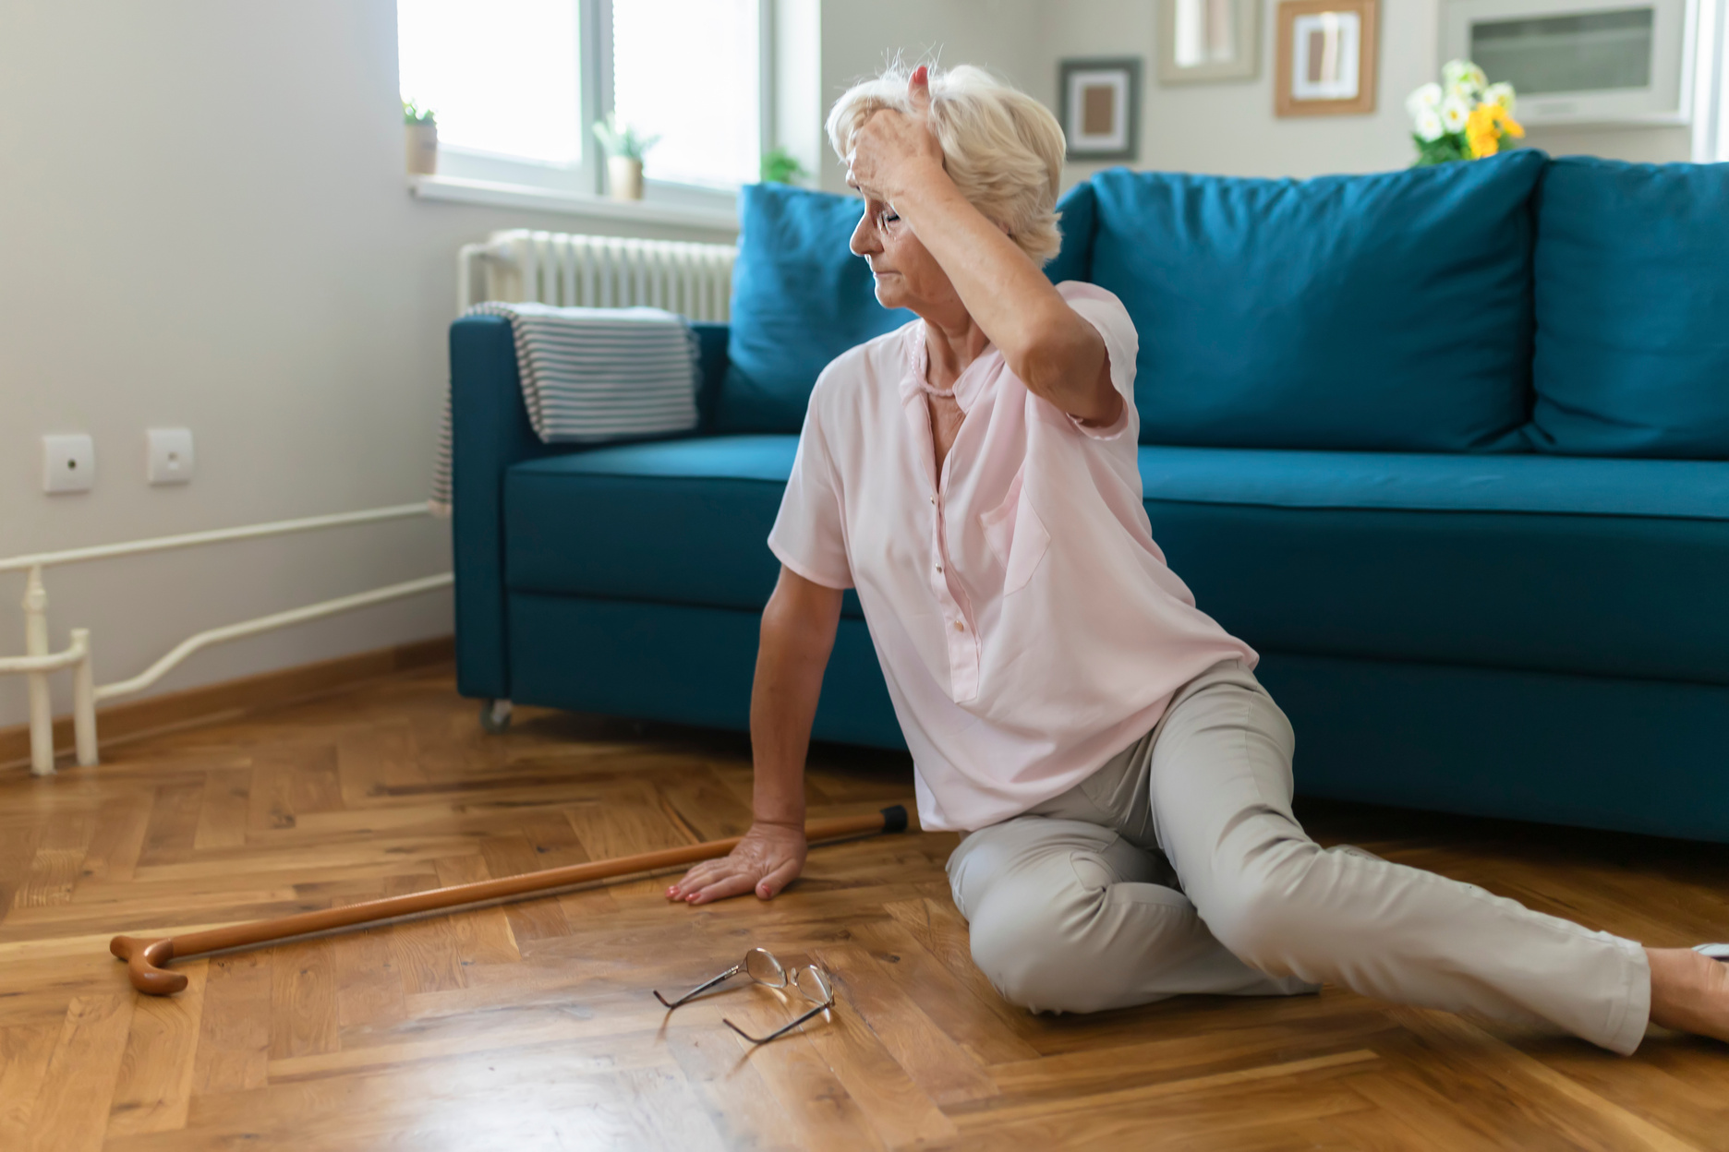
Check Your Risk
01.
02.
03.
Have you fallen in the past year?
Do you feel unsteady when walking?
Are you worried about falling?
Fear of falling can lead to less activity and more weakness.
A previous fall may mean you are more likely to fall again.
Weakness, dizziness, or poor balance can increase fall risk.
If you answered “yes” to any of these questions, talk with your health care provider about a falls risk assessment.

Slide 4

NEVER STOP
a medicine on your own
Review Your Medications
Some medicines can make you dizzy, sleepy, or lightheaded
Bring all prescriptions, OTC products, vitamins, and supplements to your appointment

Slide 5


Make Your Home Safer
Remove loose rugs and clutter
ㄱ
Improve lighting
Use handrails and grab bars
Use your cane or walker whenever you need support while walking.

Slide 6

Keep Your Body Strong
02
Choose safe activities that match your ability
01
03
Balance and strength exercises can reduce falls risk
Community programs can help you exercise safely

Slide 7

Find Local Support
Iowa Community HUB receives referrals for individuals with a fall risk
Community Falls Prevention Programs
A HUB Navigator helps connect individuals to the best fit programs/resources
Outpatient Clinics
Ask your care team to send a referral for a falls prevention program
Home Care
Make a HUB Referral

Slide 8
Iowa Community HUB Resources
Explore more available programs through the Iowa Community HUB Program Library: Program Library - Iowa Community HUB
01.
02.
A Matter of Balance
Stepping On
In-person and virtual classes are designed to help older adults reduce their fear of falling and improve their flexibility, balance, and strength. The classes are offered to participants over the age of 60.
A 7-week group program that addresses fall risk through strength and balance exercises, community mobility, safe footwear, medication management, and more! The target audience is participants aged 60 and older living on their own.

Slide 9

Check out the Iowa Falls Prevention Coalition webpage to learn more about statewide falls prevention efforts, resources, and initiatives.
03.
Home Hazard Removal Program
04.
Tai Chi for Arthritis and Tai Chi Prime
This program connects older adults with occupational therapists in the area who assess home environments and recommend modifications to reduce fall hazards.
Evidence-based Tai Chi falls prevention programs that use gentle movements to improve balance, strength, mobility, and reduce fall risk.

Slide 10

Thank You!
Stay safe.
Stay strong.
Stay independent.

Slide 11
Resources:
  Northeast Iowa Area Agency on Aging. A Matter of Balance Classes. Accessed August 7, 2026. https://nei3a.org/a-matter-of-balance/
  Milestones Area Agency on Aging. A Matter of Balance at Milestones Area Agency on Aging. Accessed August 7, 2026. https://www.milestonesaaa.org/wellness-programs/evidence-based-programming/a-matter-of-balance/
  University of Iowa Health Care. Stepping On: Fall Prevention Class. Accessed August 7, 2026. https://uihc.org/stepping
  National Council on Aging. Evidence-Based Program: Home Hazard Removal Program (HARP). Published November 1, 2023. Accessed August 7, 2026. https://www.ncoa.org/article/evidence-based-program-home-hazard-removal-program-harp/
  University of Iowa Health Care. Tai Chi for Arthritis and Fall Prevention. Accessed August 7, 2026. https://uihc.org/support-groups/tai-chi-arthritis-and-fall-prevention
  Mary Greeley Medical Center. BINGOcize. Accessed August 7, 2026. https://www.mgmc.org/healthy-living/calendar/event-search-results-detail/?eventId=33be9bfe-afbc-ef11-a877-000d3a611c21
  Sidney Public Library. Bingocize—Fremont County IA. Facebook. Accessed August 7, 2026. Facebook event page
  Western Iowa Tech Community College. Bingocize®: Play, Move, and Win! Accessed August 7, 2026. https://www.witcc.edu/lifelong-learning/wellness/bingocize-play-move-and-win/
  Iowa Community HUB. Program Library. Accessed August 7, 2026. https://iacommunityhub.org/programs/

